Slide 1

Training on
Core Project Management
- Prakash Hegde
QAI Global Services

Slide 2
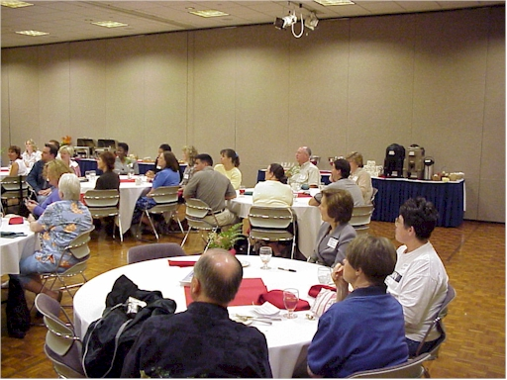
Introduction by Participants
Name
Current Role
Project experience

Slide 3
Program Objectives and Delivery Mode
Enable Conceptual understanding of Project Management practices and Principles, Understanding of the Big Picture and interconnects, Practical Implementation concepts, best practices.
( The Training would be focused on Practical nuances of Implementation).
Delivery Mode
Interactive sessions.
Case studies/Group Exercises, Presentation and Feedback discussions.

Slide 4
Training Agenda
Session 1
Introduction | Participant & Trainer Introductions Overview of Training agenda, agreement on Protocols.
Overview of Project Management | Definition of Project. The Project Triple Constraint. What does Project Management involve? Why do Projects Fail?
Project Scoping and Initiation | Project Scoping, Deliverables, Lifecycle Project Kickoff Stakeholder Identification and engagement(RACI)
Project Planning (Estimation, Work breakdown Structure, Scheduling) | Project Estimation. Components of Project Planning. Developing Work Breakdown Structure- concepts and principles; Understanding various types of Task dependencies. Resource Allocation, Resource Calendar Scheduling Techniques- Critical Path Method.
Interactive sessions driven by Case studies/ Exercises and debriefing at the end of every module

Slide 5
Training Agenda
Communication Planning | Communication Model. Elements of Communication Planning.
Risk Management | Risk Identification. Risk Evaluation. Risk Response planning. Risk monitoring & control.
Project Monitoring, Control & Reporting | Levels of Project Monitoring Tracking, Types of Project reporting
Team Management | Team Building, Motivation , Interpersonal Awareness and their influence on effective Project Management.
Project Closure | Lessons Learnt and Best Practices. Project Archival.
Skills required by a Project Manager | Project Management- Competencies required

Slide 6
Overview of Project Management

Slide 7

What is a Project?
‘A Project is a temporary endeavor undertaken to create a unique product or service’
Temporary : ‘every project has a definite beginning and a
definite end’
Unique: ‘the product or service delivered is different from
others’
  Organizations resort to Projects to achieve their strategic needs, which cannot otherwise be attained through normal operational means.
Notes:
Seven wonders of the world
Pyramids
Product or service or capability to create the product/service(building, business function, org restructuring), research project)
Temporary- end- when proj objectives are met or not met or cannot be met-; need no longer exists-aborted.
Uniqueness- contactor, budget, configuration, location..etc; repititive elements could be there---similar projects or degree of similarity.
Portfolio, Program, Project
Portfolio- L&T Infra dvision—has projects in oil, power, gas, water, airport…(portfolio)-objective to maximize returns; program –within power (projects in power or in airport)
I may have a portfolio of stocks across Banking, Infra, commodities, IT….Banking stocks are from banking program (inter dependencies--)

Slide 8
Project Triple constraint
Cost
Time
Scope
Evaluate the competing demands and their impact on
project outcomes.
Notes:
Atleast 1of the sides need to be changed….tie you with chains and say now perform

Slide 9
What is Project Management?
‘Application of knowledge, skills, tools and techniques to project activities to meet the Project requirements’
People with skills, knowledge and motivation
PEOPLE
Tools and Techniques to perform Processes
Procedures and methods defining the relationship amongst tasks
PROJECT
MANAGEMENT
PROCESSES
TOOLS
Notes:
Processes – Communication
Tools – Knowledge, Skills
Resource comes from the organization.

Slide 10
Project Management Process Groups (PMBOK)
Monitoring and Controlling
Planning
Initiating
Closing
Executing

Slide 11
Initiating Process Group
SOW/Contract/MOU………
The Project and the Project Manager come into existence.
Project Charter – heralds the launch of the Project.
Project Kickoff.
Notes:
Herald – to announce something important – existence of project

Slide 12
Planning Process Group
Planning processes are important – as the project involves ‘doing something that has not been done before’
Amount of planning should be commensurate with
  Project Scope.
  Product Scope.
PLAN WHAT YOU WILL DO

Slide 13
Executing Process Group
Putting the Project Plan to work.
Actually performing project work to generate project results.
Coordinating project team members, support staff and other resources to carry out the project plan.
DO AS YOU PLANNED

Slide 14
Controlling Process Group
Monitoring Project progress regularly to identify variances from the plan.
Taking of corrective actions.
Taking of preventive action in anticipation of possible problems.
CHECK WHETHER YOU HAVE DONE AS YOU PLANNED, ACT ON THE DIFFERENCE

Slide 15
Closing Process Group
Bringing the project or phase to an orderly end and formalizing acceptance.
  Administrative Closure
    Generating, gathering, disseminating information to formalize project completion.
Take the Learnings from your Planning, Doing and Acting , forward…..
Notes:
Within each group the process groups repeat.

Slide 16


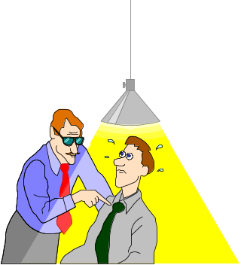
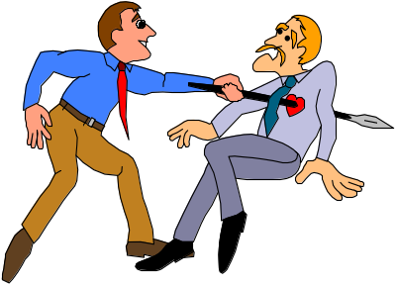
Typical Stages of a Project (the Emotional Lifecycle)
Stage 1: Excitement & Euphoria
        Initiation
        Planning
Stage 2: Disenchantment
        Execution
Stage 3: Search for the Guilty
        Control
Stage 4: Punishment of the Innocent
        Closure
Notes:
Three chits- blame the predecessor; re-organize the team; make 3 more chits

Slide 17
Why do Projects fail?
Lack of User Input/involvement.
Lack of Executive support.
Unrealistic Expectations.
Unclear/changing Goals.
Incomplete Requirements & Specifications.
Changing Requirements and Specifications.
Lack of appropriate methodologies.
Lack of experienced Project Manager.
Lack of skilled staff.
Poor estimation and planning.
Failure to communicate and act as a team.
Poor Risk Management.
Lack of Vendor control.
Abstracted from Standish group report

Slide 18
Project Initiation

Slide 19
How do Projects arise?
Organizations identify a business need that can be satisfied by executing a Project.
Projects can be ‘Internal’ or ‘External’.
Projects may arise out of many factors including:
  Market/ customer demands.
  Need to improve internal processes.
  Technology upgradation and Legal requirements.
  Social needs.

Slide 20


Develop the Project Charter
Objectives
Scope
Constraints
Project Charter
Assumptions
Risks
Sign off by Management
The Project Manager
The Stakeholders
Notes:
Constraints- resources, budgets, timelines

Slide 21
Understand Project Scope-
Project Scoping Tool
In the Frame / Out of the Frame Flip Charts
Notes:
Areas IN GREY—tbd….TICKING bomb …by when…tbd till end of project;sitting on the fence
Functional, Non functional- user manual, training, installation, user support,

Slide 22
Project Kickoff
Forum for :
Communication and engagement of Stakeholders.
Arrive at shared understanding of Project scope, objectives, key success factors, dependencies, risks.
Decide Preventive actions based on understanding of lessons learnt in the past.
Notes:
Yr forum to speak…do yr ground work……share all the context from proposal stage till now…; contractual obligations

Slide 23
Understanding Project Lifecycle
Performing Organization/ Stakeholders
Phase
I
Phase
II
Phase
III
Phase
IV
Closure
Initiation
Exits
Exits
Exits
a
b
c
d
Deliverables
Notes:
What is a lifecycle? Delivery strategy
Conceived, born, childhood, teenage, adult, working adult, married adult, parent, retired, obsolete
(transition from one state to the other needs to be clearly defined--tollgates)
Phase- logical grouping of related tasks, deliverables
Hybrid models
SAP-LIFECYCLE- Proj preparn, Bus blueprint,realizn, Final preparn, Go live and support

Slide 24
Waterfall Lifecycle
Requirements
Engineering
Design
Construct
(CUT)
Integration Testing
System Testing
Release
Acceptance Testing

Slide 25


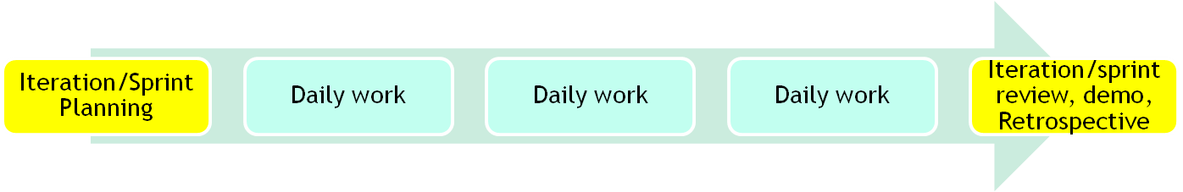
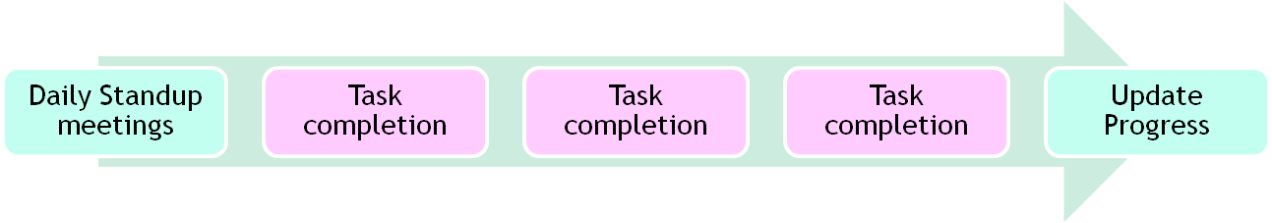
The Agile Methodology

Slide 26






Project Stakeholders
“Individuals and organizations that are actively involved in the project, or whose interests may be positively or negatively affected as a result of project execution or project completion”.
Performing
Organization
Product’s
End-user
Project
Sponsor
Project
Team
Members
Customer
Project
Manager
Notes:
Stakeholders:
-who contribute/influence the outcome of a project or who get influenced by the outcome of the project.; stake in the project
--Training example
-Business results –quarterly reports—employees, media, analysts, shareholders, vendors, stock exchange-regulations, customers
Circle 1- PM and his team
Circle 2- Sponsor, PMO, Functional Managers, Support funcs-HR,IT,Finance…
Circle 3- customers, vendors, govt-regulatory bodies, Income tax, sales tax, shareholders

Slide 27
Engaging the Stakeholders- The RACI Matrix – an example
(Responsible, Accountable, Consulted, Informed)
Project Phase & Deliverables/Activities | Stakeholders & RACI
 | Role 1 | Role 2 | Role 3 | Role 4 | Role 5 | Role 6
Phase 1
Deliverable 1 | R | I | C | A | C | I
Deliverable 2 | A | R | I | I | I | C
Phase 2
Deliverable 1 | R | A |  | I | C | I
Deliverable 2 | A | R | C |  | C | C
Deliverable 3 | I | A | I |  | R | I
Phase 3 | A | R | I | I | I | C
Deliverable 1 | A | R | C |  | C | C
Deliverable 2 | I | A | I |  | R | I
Notes:
In the making of an egg, the hen is involved; in the making of a bacon, the pig is committed; the buck finally stops here;head on the scalp.
Only 1 time in a row..Accountable

Slide 28

Project Planning

Slide 29
Estimation Process flow
Requirements or SOW
Identify Estimation team
Estimate Size
Historical Database
Estimate Effort
Determine Resource Need
Classify the project and identify the method
Estimate Schedule
Cost Data
Draw up the schedule
Estimate Size, Effort, Schedule and Cost
Estimate Cost
Apply constraints (resources, deadlines)
Review and approve effort estimates
Adjust Schedule
Revisit estimates at the end of every phase.

Slide 30
Wideband Delphi
Wideband Delphi is a process that a team can use to generate an estimate
  The project manager chooses an estimation team, and gains consensus among that team on the results.
  Wideband Delphi is a repeatable estimation process because it consists of a straightforward set of steps that can be performed the same way each time.

Slide 31
The Wideband Delphi Process…contd.
Step 1: Choose the team
  The Project manager selects the estimation team and a moderator. The team should consist of 3 to 7 project team members.
    The moderator should be familiar with the Delphi process, but should not have a stake in the outcome of the session if possible.
    If possible, the Project manager should not be the moderator because he should ideally be part of the estimation team.

Slide 32
The Wideband Delphi Process…contd.
Step 2: Kickoff Meeting
  The project manager must make sure that each team member understands the Delphi process, has read the vision and scope document and any other documentation, and is familiar with the project background and needs.
  The team brainstorms and writes down assumptions.
  The team generates a WBS with 10-20 tasks.
  The team agrees on a unit of estimation.

Slide 33
The Wideband Delphi Process…contd.
Step 3: Individual Preparation
  Each team member independently generates a set of preparation results.
  For each task, the team member writes down an estimate for the effort required to complete the task, and any additional assumptions he/she needed to make in order to generate the estimate.

Slide 34
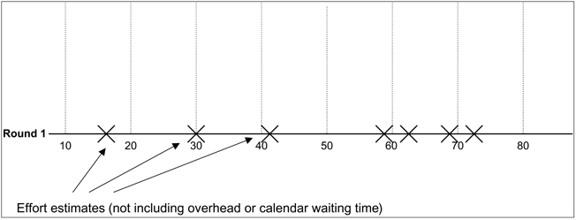
The Wideband Delphi Process…contd.
Step 4: Estimation Session
  The moderator collects the estimation forms and plots the sum of the effort from each form on a line. Individual estimates are not pointed out. Assumptions are listed for each estimate.

Slide 35
The Wideband Delphi Process…contd.
Step 5: Estimation Session ..contd.
  The team resolves any issues or disagreements that are brought up.
    Disagreements are often resolved by adding assumptions.
  The estimators all revise their individual estimates. The moderator updates the plot with the new total.

Slide 36
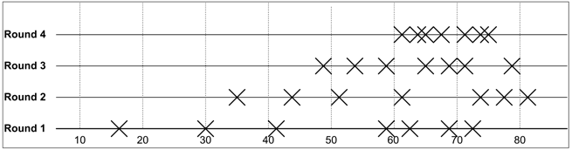
The Wideband Delphi Process
Step 6: Estimation Session (continued):
  The moderator leads the team through several rounds of estimates to gain consensus on the estimates. The estimation session continues until the estimates converge or the team is unwilling to revise estimates.
Step 7: Review Results
  The project manager reviews the final task list with the estimation team.

Slide 37
The Work Breakdown Structure
The Work Breakdown Structure is a hierarchical chart used to organize the tasks of a project into related areas
It shows the breakdown of a project depending on the visibility and control needed
Each of these major components are then subdivided into the tasks necessary to reach successful project completion
Notes:
Decomposing till what level of granularity…till duration of the task is not more than 5 working days. Based on project duration/milestone…..if project is 15 days..then daily/agile.
Verbs, specific outputs that are measurable
More the granularity , more the visibility, more is the possibility of control; greater is the PM overhead. But for long durn, weekly may be too much; tied to tracking and reporting needs.
Breakdown to atleast 2 levels
Should be assignable, trackeable, estimatable
But for a new team member, greater; or only at TL level…they will in turn breakdown

Slide 38
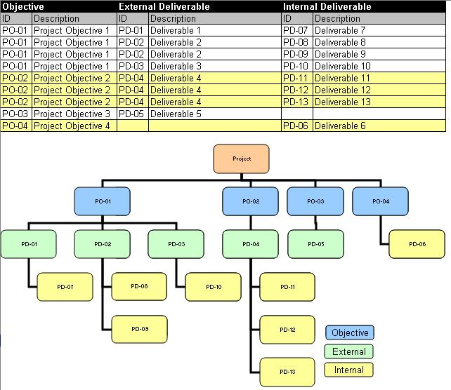
Definition of Deliverables
A Deliverable is a measurable, tangible, verifiable outcome, result, or item
that must be produced to complete a project or part of a project.
Deliverables may be External or Internal.

Slide 39
The Work Breakdown Structure
It is a basic project diagram that describes all the work that must be done to complete the project.
The Work Breakdown Structure is a hierarchical chart used to organize the tasks of a project into related areas.
It shows the breakdown of a project depending on the visibility needed.
Each of these major components are then subdivided into the tasks necessary to reach successful project completion.

Slide 40
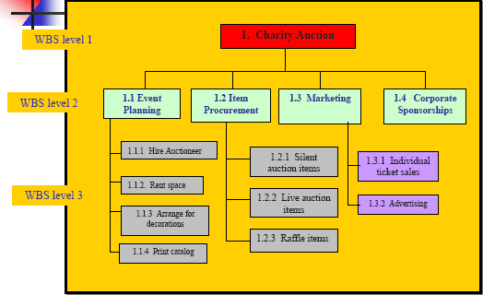
WBS- example

Slide 41
WBS template
Assumptions:
1.
2.
WBS element | Activities-Level 1 | Activities-Level 2
Training | A .1.1 | A. 1.1.1
 |  | A. 1.1.2
Travel | A.2.1 | A.2.1.1
 |  | A.2.1.2
 |  | A.2.1.3

Slide 42

Project Time Management

Slide 43
Dependency – Logical Relationships
Mandatory dependencies – Logical relationships inherent in the set of
activities
Discretionary dependencies – Dependencies which are defined by the
Project team or the Performing organization
  May involve ‘Good industry practices’ – like adoption and implementation of applicable standards
External dependencies – relationships between Project and outside
organization
Notes:
Discretionary dependencies– cannot process ahead without milestone review/ qa audit/ baselining/ signoff etc.

Slide 44
Lags and Leads
Lag :
The amount of time delay between the completion of one task and the start of its successor task.
Lead:
Is A Negative Lag
The successor activity starts before the predecessor activity has finished.

Slide 45
Schedule Development - Inputs
Resource Pool Description - Knowledge of what resources will be available, at what time and in what patterns.
Calendars – When work is allowed
Working and Non-working times
Constraints
  Imposed Dates
  Key Events or Major Milestones.
Notes:
Factors considered: convert 5 working day effort to schedule(start Mon…; 1 person working)
-working days(weekends, holidays), part time/full time, dependency /wait time on another activity/resource, time zone-diff, personal leave, effective work hours/per day-org activities, early going, productivity(factored in estimate of 40 working hrs)…
Can finish early..if more hrs/per day/no dependencies, more productive than assumed,….
-

Slide 46
Schedule Development technique: Critical Path
A Critical path for a project is the series of activities that determines the earliest time by which the project can be completed.
The Critical path is the longest path through the network diagram.

Slide 47
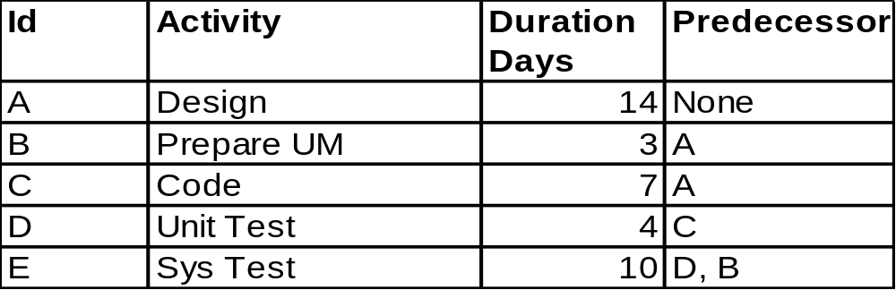
Critical Path Method (CPM)-Example
B : Prepare UM
E : Sys Test
3 days
10 days
14 days
A : Design
4 days
7 days
C : Code
D : Unit Test

Slide 48
Critical Path
Using the Critical path:
  If one or more activities on the critical path takes longer than planned, the whole project schedule will slip, unless corrective action is taken.
  Slack or float is the amount of time an activity may be delayed from its early start without delaying the project finish date.
The critical path is not the one with all the critical activities; it only accounts for time.
  There can be more than one critical path – the more they are – more risky it is for the Project Manager.
  The critical path can change as the project progresses.

Slide 49
Critical Path…..contd.
To shorten the project, focus on critical path activities.
Is a powerful tool for top level reporting and resource requisition.
Escalation of durations of non-critical activities beyond a point may result in having additional critical paths.
Notes:
Self Explanatory slide !

Slide 50
Communications Management

Slide 51
Communication Model
TRANSMITTER /
COMMUNICATOR
FEEDBACK
ENCODING
NOISE
MEDIUM
PERCEIVING,
DECODING,
INTERPRETING
RECEIVER
Notes:
Uhde- fax to Germany; virtual, barriers
Communican costs, blocking meeting rooms, ABC costing

Slide 52
Improving Communications
Make the message relevant to the receiver.
Reduce the message to it’s simplest form..
Organize the message into a series of stages
Repeat key points and obtain the reverse feedback.

Slide 53
Elements of Communication Planning
Who do you need to talk to
Why are we talking to them
What do they need to know
When to tell them - timing
How do you communicate with them. Who does the telling
Where to tell them – the medium ~

Slide 54
Communications Plan- Example
Audience | Senior Management Team
Reason | Financial responsibility for project
Event | Monthly project expenditure report
Responsible | Project Manager
Medium | Presented at exec meeting
Timing | Monthly
Content | Expenditure to date v budget, estimate to finish, updated cash flow, anything that should be brought to the attention of the team

Slide 55
Risk Management
Notes:
Positive risk--- eg SLA based contract; reward for early completion; penalty for delay. 2 PMs could look at same thing as a positive or negative risk; maximixe opportunity from early completion or minimize losses from penalty.

Slide 56
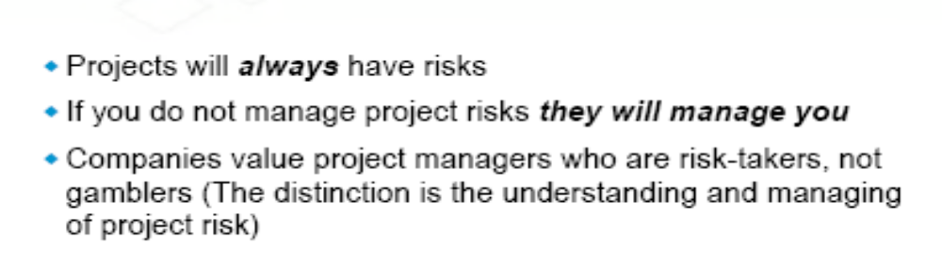
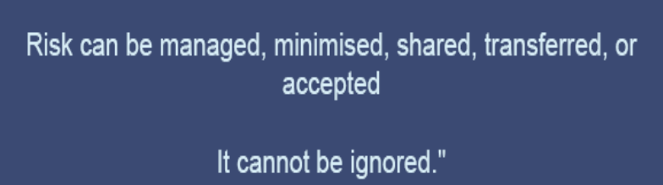

Introducing you to the World of Risks
Un-predictable Risks
Known Risks
Management of Uncertainties

Slide 57
Every Project has risks associated with it!
Commercial viability.
Technical feasibility.
Competitors move ‘faster’.
Customers’ preferences may change.
‘VC’ resources may ‘dry up’.
Project Sponsor changes or may not give continued support.
Attrition.
Project scope, time or cost related issues.
Government regulations.
Notes:
Technical risks- lifecycle, product/technology obsolescence
Management risks- Planning, estimation, budgeting, resources
Commercial- exchange rate , payment default
Legal- obligns failure

Slide 58
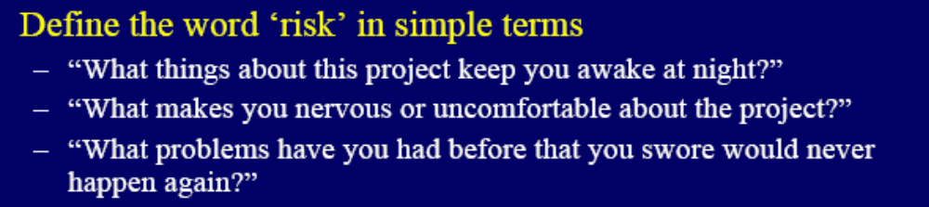
What is Risk?
A dictionary definition of risk is “the possibility of loss or injury”.
Project risk involves understanding potential problems that might occur on the project and how they might impede project success.
“Risk is the potential for realization of unwanted negative consequences of an event.”
Project Risk is an uncertain event or condition, that if it occurs, has a positive or negative impact on project objectives. (PMBOK)

Slide 59
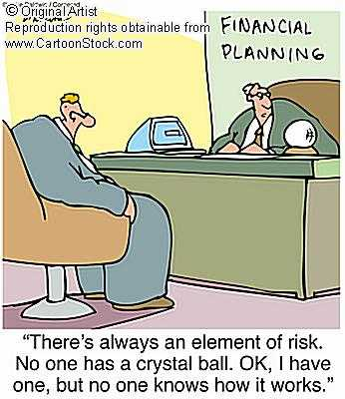
RISK IDENTIFICATION

Slide 60


Risk Identification – Information gathering Techniques
  Brainstorming Sessions.
  Interviewing.
  Checklists.
  Assumptions analysis.
  Review of Artifacts (WBS etc).
  SWOT Analysis
  Organization Risk Database.

Slide 61


Risk Management Process
Risk Assessment
Risk Control
Risk Database
Risk identification
Risk analysis
Risk prioritization
Risk response planning
Risk resolution
Risk monitoring
SDLC
Notes:
Self Explanatory slide !

Slide 62
Risk Event / Impact matrix
Contingency
Reserve
Management
‘kept’ Reserve
Unknown
Impact
Planning
N.A.
Known
Known
Unknown
Event
Notes:
Unknown unknown- Recession, customer demand/appetite changes, technology changes, new product-game changer has hit the market, farmer agitn –singur—recovery/continuity at Gujarat..
Known-known--- cust may not signoff; team member may leave, resource may not be available..
Known- unknown-----I know customer changes his mind, but don’t know impact;
Unknown-unknown--- don’t know if cycle will change; don’t know if recession might happen; don’t know if suddenly regulations change; don’t know whether customer may delay payment; don’t know if competition announces new changes.

Slide 63
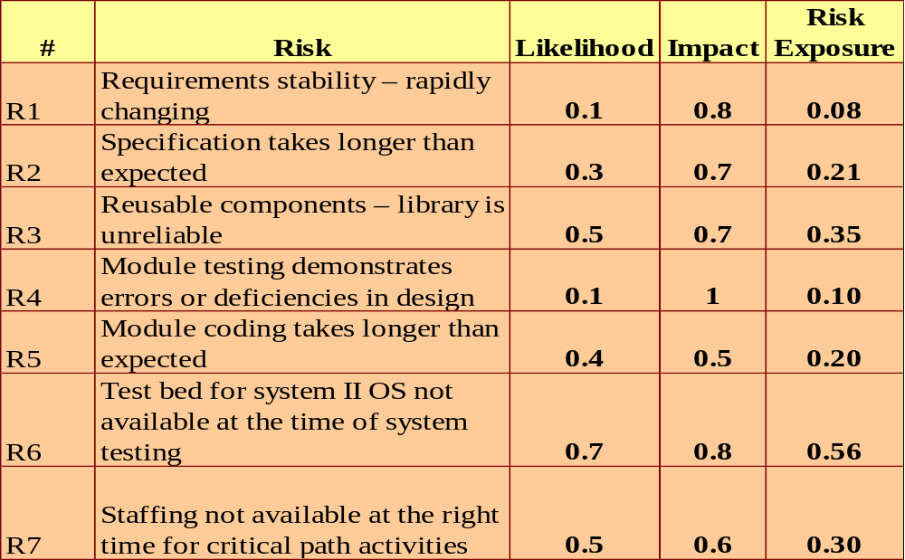
Risk Estimation

Slide 64
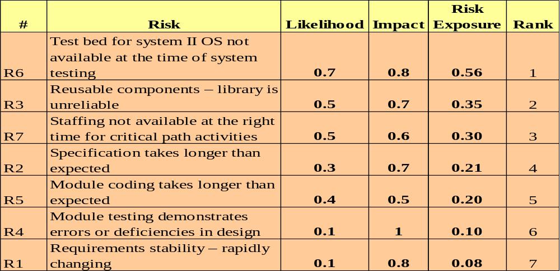
Risk Prioritization
Rank each of the risks according to their risk likelihood and exposure

Slide 65
Risk Response Strategies
Risk Avoidance
Risk Transference
Risk Mitigation
Risk Acceptance

Slide 66
Risk Monitoring & Control
Keeping track of identified risks
Monitoring of residual risks
Identifying new risks
Ensuring execution of the Risk Plan
Evaluating the effectiveness of the Risk Plan
Will be an ongoing process for the life of the project
Will reassess the priority of the risks periodically.

Slide 67
Good Risk Management Practices
Acknowledge that risks are inevitable.
Communicate risks openly.
Reward people who prevent crisis, not just those who create crises and then manage them.
Use organization’s risk database for cross project learning.
Take the Expert help whenever needed.
Remember all risks are important .
Notes:
Self Explanatory slide !

Slide 68
Bad excuses for not doing Risk Management
We have no risk.
We deal with problems as they arise.
How can you predict what will happen 6 months from now?
Our job is to develop software, not to fill out bureaucratic forms.
That external interface is not in our risk management program because the interface is not our responsibility.
We deal with problems as they arise.
That method is proven and therefore not a risk. The speaker at the conference said so.
My tech people will rebel if we identify as a risk a lack of skills needed to do development.
We have to bid the lowest cost to win; we'll worry about doing the job when we get it.
(source-The Little book of bad excuses- SPMN)

Slide 69

Project Monitoring and Control ,Reporting
Hard(ly) work(s)

Slide 70
Project Progress
How does a project get to be a year late?
……. one day at a time
-------------------------------------------------
Just Planning is not Enough !!!!
……. Fred Brooks
Notes:
Self explanatory slide !

Slide 71
The Problem
“What’s the status of project?”
“What are you doing today?”
“When will you be finished?”
“Why is it taking so long?”
“Have you finished _______, yet?”

Slide 72
Managing Variations
Variation:
The difference between the planned and the actual results. Variation could be with respect to Time, Cost or Quality.
Threshold:
The maximum permissible variation beyond which appropriate corrective action must be taken.
Notes:
Talk about:
Explain the definitions of variation and threshold and say that more will be discussed in the subsequent slides

Slide 73
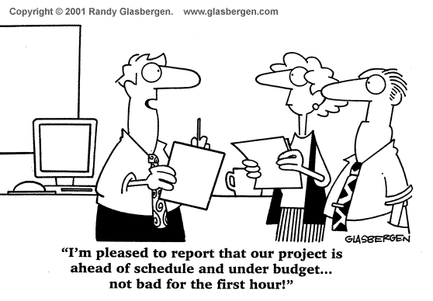
Monitor Estimates vs. Actuals

Slide 74
Types of Reviews/reports
Weekly reviews
Status/Progress reviews
Management reviews
Milestone/phase end reviews
Customer reviews
Vendor reviews

Slide 75
Project Review outcomes
All reviews must culminate with
  List of Issues Identified.
  List of Action Items decided.
Action items must be tracked to closure.
Issues must be monitored to determine if they are resolved.
Issues need to be escalated as per the defined Escalation procedures.

Slide 76

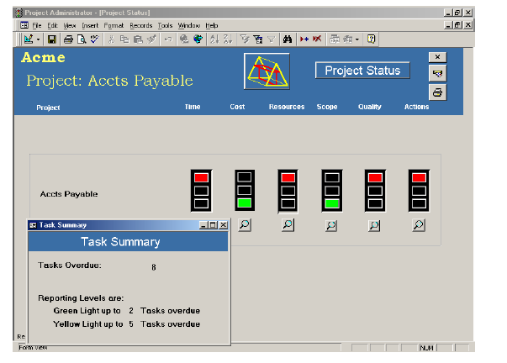
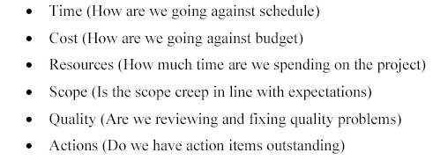
Project Dashboard (RAG)

Slide 77
Issue Management
Log issues and Issue source.
Determine action for resolution.
Establish responsibilities and timeline for action.
Track issue for resolution.
Escalate issue as per escalation procedure.

Slide 78

Team Management
Together Everyone Achieves More

Slide 79
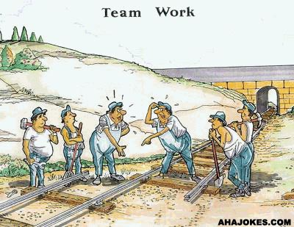

Slide 80

Team dynamics

Slide 81
Tuckman’s Model of Group Development
Forming
Storming
Norming
Performing

Slide 82
Stages of Team Performance
Forming :
  Team members getting to know each other
  Heavy dependence on Leader’s directions
Storming:
  Team members vie for positions of authority/ Power struggles
Norming:
  Team members get to know each others’ strengths and weaknesses
  Agreement and Consensus/ Goal clarity
  Leader – facilitating role
Performing:
  Team has a shared vision
  Conflicts are resolved productively
  Leader – delegating and overseeing role
Notes:
Cliques – A group of people or associates

Slide 83
Motivation
The internally generated state (feeling) that stimulates us to act.
Internal process which creates and maintains the desire to move toward goals.
The driving force within that causes an individual to act in order to achieve a specific goal.

Slide 84
Maslow’s Need Pyramid
Self Actualization
& fulfillment
Esteem
& Status
Belonging &
Social needs
Safety & Security
Physiological needs

Slide 85
Johari Window
A Framework for Interpersonal effectiveness
Known to self
Not known to self
Known
to Others
Quadrant 1
Quadrant 3
Not Known to Others
Quadrant 2

Slide 86
Project Closure

Slide 87

What is a Post Project Review?
A summary of project development, start to finish.
A brief description and analysis of
  Project activities
  Results
  Lessons learned
  Recommendations
An improvement tool
  NOT a record of failures

Slide 88


Why do a Post Project Review?
Learn from project experiences.
Retain knowledge for future projects.
Identify areas to improve.
Understand successes.
Provide team/individual feedback.
Split into two parts
  Looking backwards
  Looking ahead

Slide 89

What’s Involved?
Collect the information
  Technical
  Managerial
  Metrics
  Schedules
Anything kept during the project
  Manager or project logs
  Emails
  ...
  Identify three things you would continue to do ?
  Identify three things you would stop doing ?
  Identify three things you would start doing ?

Slide 90
What’s the Deliverable?
Reuse possibilities
Best Practices
Lessons Learnt
Risks That hit / hurt
Customer / Project / Process / Product measurements
Customer report defect data analysis
  Input for preventing defects in subsequent phases / projects
Customer Satisfaction Survey Analysis
Contributed to organizational repository for further processing

Slide 91
Groundrules
Be polite and gracious.
Focus on problems and process.
No finger pointing.
No assigning blame.
No “You’s”
Let each person have a turn.
Avoid defensiveness.
Respect everyone’s perspective.
NOT!
Off with her head!!!
Off with his head!!!

Slide 92
Project Archival
Ensure that all information is archived in line with the contractual agreements/internal procedures.
Plan for transitioning to warranty / maintenance.

Slide 93

Role of the Project Manager
Wrap up Discussion
Notes:
Provide leadership in Planning, Organizing, Coordinating and Controlling the Project work.
Define and Communicate the Project Objectives.
Plan the Project.
Secure appropriate resources.
Assign responsibilities and delegate authorities.
Identify and engage stakeholders.
Track the project.
Take corrective actions.
Report progress, issues.
Build, develop and Manage the project team.
Identify and Manage Risks.
Ensure Process Compliance.
Release of resources.
Administrative closure.
Project Knowledge management

Slide 94
Project Manager
-Knowledge and Skills required

Slide 95
Knowledge and Skills
General Management knowledge, skills and competencies.
Technical knowledge, skills and competencies.
Interpersonal Skills.

Slide 96
General Management Knowledge & Skills
Financial Management & accounting
Procurement
Sales & Marketing
Contracts & Commercial law
Manufacturing & Distribution
Logistics & Supply chain
Strategic and Tactical planning
Org structures, org behavior,compensation, benefits
Health & Safety practices
Information Technology

Slide 97
Technical Knowledge & Skills
Uses knowledge that is acquired through formal training or extensive on-the-job experience ; works with, understands, and evaluates technical information related to the job; advises others on technical issues.

Slide 98
Interpersonal Skills
Effective communication
Influencing the organization
Leadership
Motivation
Negotiation & Conflict Management
Problem solving

Slide 99
ALL THE BEST

